Slide 1

Notes:
Please save the source video file in your system and go to Insert > Video > Video on my PC > Select the file to insert. The headline should remain visible. DO NOT SHARE THE VIDEO FILE EXTERNALLY.

Slide 2
HACKATHON EXPECTATION SETTING
AND
PROBLEM STATEMENT ANNOUNCEMENT
Notes:
Please save the source video file in your system and go to Insert > Video > Video on my PC > Select the file to insert. The headline should remain visible. DO NOT SHARE THE VIDEO FILE EXTERNALLY.

Slide 3
HACKATHON RULES
Team Size: 4-5 coders & 1 Mentor per team
Fresh code only
Code Quality and Review
Reach out to the mentor for any clarifications at any point
Utilize the pitstops to get feedback on your progress
Adhere to the timelines and attend the scheduled events
Ensure all the code that is being run for final demo is checked-in to GIT repo.
Work as an inclusive team and utilize everybody’s skills
Enjoy the Experience and make full use of time

Slide 4



JUDGING CRITERIA
Criteria | Description | Weight
Creativity | How creative or innovative is the approach adopted for the given idea/ challenge? (architecture, design and implementation)? | 20%
Innovative Technology | How have you utilized the existing technologies to the solution? | 20%
User experience and functionality | Is the overall user experience intuitive? Does the flow make sense? | 15%
Simplicity | How elegantly does it solve the problem (smart vs harder)? | 15%
Completeness | How much was accomplished in two days? | 15%
Demo & Presentation | How well did the team present? | 15%
Gold Standard – Excels in all categories, is innovative & unique
Silver Standard – Excels in few categories, is innovative & relatively good
Bronze Standard – Excels in few categories and is relatively good

Slide 5
DEMO CHECKLIST
Presentation deck should contain a title page with your team name and names of group members.
Do not include content available on internet or a paid/licensed platform.
Ensure that the content on your presentation is readable.
Do not embed any video or links in your presentation.
Use less text and more block diagrams to explain your approach, screenshots to show the output
Don’t spend time explaining the problem. Explain your solution and highlight the differentiating features
Clearly highlight the Must have, Good to have and Optional features that have been built.
Cover the technologies you have used and the reasoning behind selecting those
Plan the sequence of your demo and organize your team so that everyone has a role to play in the demo.
During demo if any feature breaks, just explain and move on. Don’t try to make it work that time
In the end, try to cover what more can be done to make your app better

Slide 6
PROTOTYPE VIDEO GUIDELINES
This video should be prepared and should be kept ready as a back up
The video should not exceed two minutes.
Please ensure that the video is recorded in a very well lit, noise free environment.
Make sure that the audio quality is good.
You are not allowed to include content available on internet or a paid/licensed platform.
Clearly highlight the Must have, Good to have and Optional features that have been built.

Slide 7
USE CASE 1 – AR MODELLER
Notes:
Please save the source video file in your system and go to Insert > Video > Video on my PC > Select the file to insert. The headline should remain visible. DO NOT SHARE THE VIDEO FILE EXTERNALLY.

Slide 8
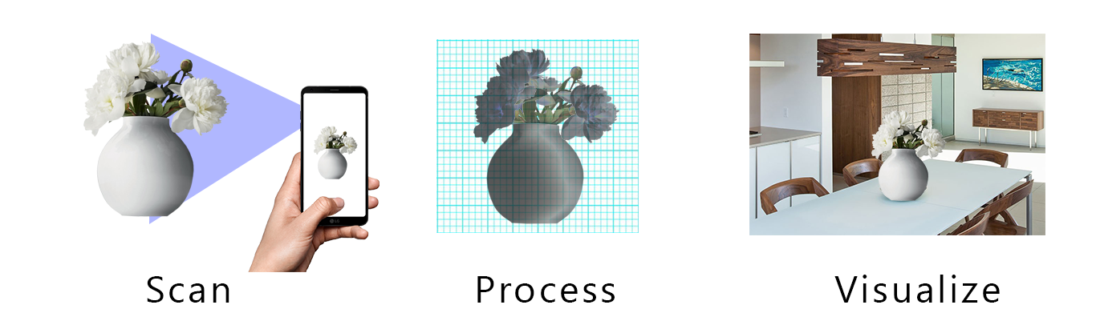
PROBLEM STATEMENT & EXPECTATIONS - AR MODELLER
Business Context
Covid-19 has supercharged all things virtual, propelling industries like retail well into the future. According to IBM’s 2020 U.S. Retail Index report, the pandemic has accelerated the shift to digital shopping by roughly five years.
Augmented Reality (AR) applications have been on the rise with virtual “try-before-you-buy” experiences ranging from previewing furniture and products in your home with everyday brands like IKEA and Home Depot, to virtually trying on luxury fashion such as Louis Vuitton and Gucci. Once a nice-to-have feature, AR has quickly become an essential technology for retailers. Still, majority of retailers don't have AR integration for their online platforms.
One of the reasons for this is that it takes a considerable effort to create 3d models for products manually and the lack of easy AR plugins for existing online retail channels. The goal is to build a system that can create 3d models of products and a way to visualize them in AR. The high-level process would be as below:

Slide 9
PROBLEM STATEMENT & EXPECTATIONS - AR MODELLER CONTD.
Must Have Features
Ability to create a 3d model of real-world objects and save it in a common format (obj,STL,3MF, coloured STL, PLY).
Ability to display the created model in AR mode (try-before-you-buy) without needing to install additional apps.
Good to Have Features
Ability to improve the created models (mesh optimizations , smoothening etc).
Ability to scan objects of different sizes .
Ability to generate realistic shadows and reflections for the 3d object based on the environment where it is placed.
Ability to preserve the scale of the object when it is placed in AR.

Slide 10
PROBLEM STATEMENT & EXPECTATIONS - AR MODELLER CONTD.
References
The solution essentially consists of two parts - 3D model creation and AR viewer. There are many existing techniques and solutions for both parts that can be used as reference
AR for the web
https://developer.mozilla.org/en-US/docs/Web/API/WebXR_Device_API
WebXR sample projects
https://immersive-web.github.io/webxr-samples/
https://developers.google.com/web/updates/2018/06/ar-for-the-web
3D Reconstruction
https://en.wikipedia.org/wiki/3D_reconstruction_from_multiple_images
Meshroom
https://github.com/alicevision/meshroom

Slide 11
USE CASE 2 – VIRTUAL STYLIST
Notes:
Please save the source video file in your system and go to Insert > Video > Video on my PC > Select the file to insert. The headline should remain visible. DO NOT SHARE THE VIDEO FILE EXTERNALLY.

Slide 12
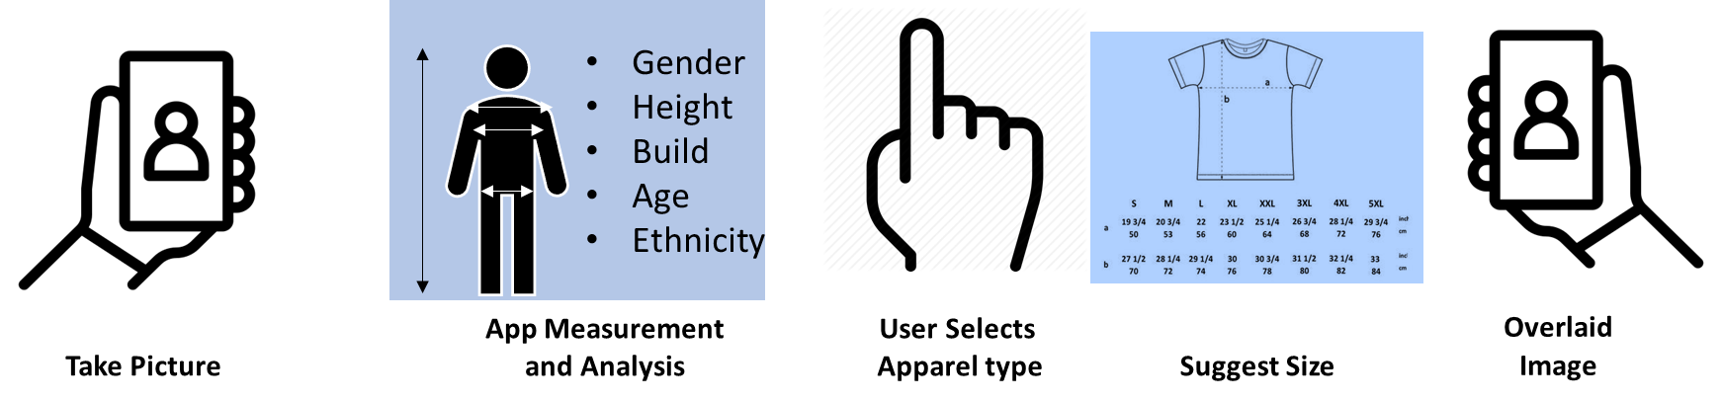
PROBLEM STATEMENT & EXPECTATIONS – VIRTUAL STYLIST
Business Context
As customers adopt ecommerce more and more, it is becoming essential to provide a wholistic shopping experience, especially in the world of apparel. Who would like an ill-fitting dress or an expensive apparel that doesn’t suit their personality...
In an effort to bring back the joy of shopping, this solution makes an effort to cover every aspect of the apparel shopping experience to ensure that the customers get the best fitment and are able to visualize themselves in the apparel to make the right choices. This will also reduce returns and provide a personalized online shopping experience.
The solution will involve the ability to gauge the build of the customer to suggest the apparel size depending on the type of apparel and provide a virtual try-on visualization so that the customer can decide on colours, fitment etc. The high-level process would be as below:

Slide 13
PROBLEM STATEMENT & EXPECTATIONS – VIRTUAL STYLIST CONTD.
Must Have Features
Ability to gauge the distance of the camera from the customer to be able to calculate the body measurements accurately. This could be done using the camera sensors or April tags.
The measurements should include the typical dimensions required for fitment of 2-3 commonly purchased apparel, eg. T-shirt, Jeans, Dresses
App should have the ability to gauge the age range of the customer
App must allow users to visualize how the garment will look and fit on themselves in different styles, colours
Good to Have Features
App could further suggest colours and styles depending on the customers past choices, ethnicity, age or body type
App could show a comfort heatmap to show pressure points and fitment details so customer could select size or apparel styles based on their comfort preferences.
App should allow storage of a limited number of looks that could be compared side by side before making the final purchase.

Slide 14
PROBLEM STATEMENT & EXPECTATIONS – VIRTUAL STYLIST CONTD.
References
Object Detection Training Scripts
https://github.com/uniquetrij/tf2-object-detection-trainer
https://github.com/jainhitesh9998/age_gender_ethnicity_detection_keras
Deep Learning on Android https://www.tensorflow.org/lite/guide/android
Google Colab https://colab.research.google.com/
April Tags https://www.pyimagesearch.com/2020/11/02/apriltag-with-python/
Age and Gender detection https://becominghuman.ai/detecting-age-and-gender-with-tf-lite-on-android-33997eed6c25

Slide 15
USE CASE 3 – VIRTUAL ASSIST
Notes:
Please save the source video file in your system and go to Insert > Video > Video on my PC > Select the file to insert. The headline should remain visible. DO NOT SHARE THE VIDEO FILE EXTERNALLY.

Slide 16
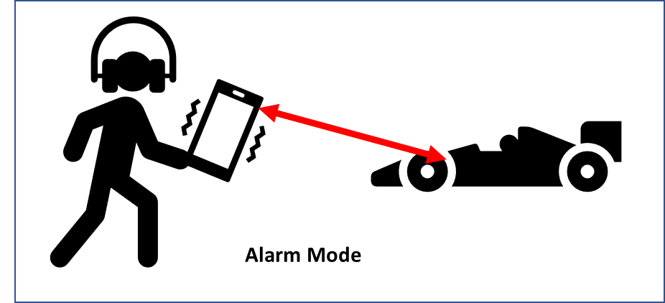
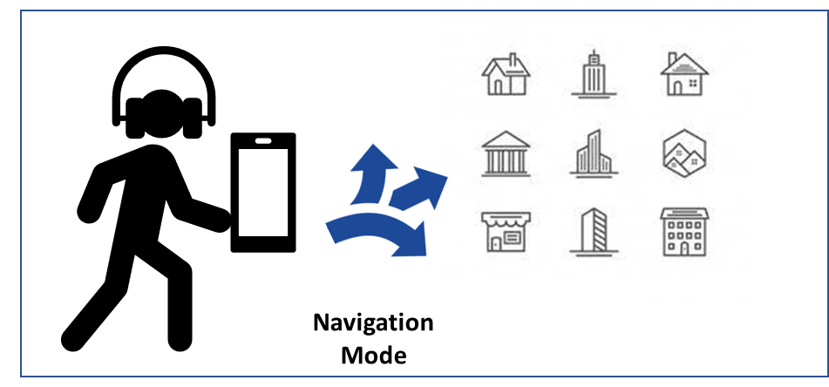
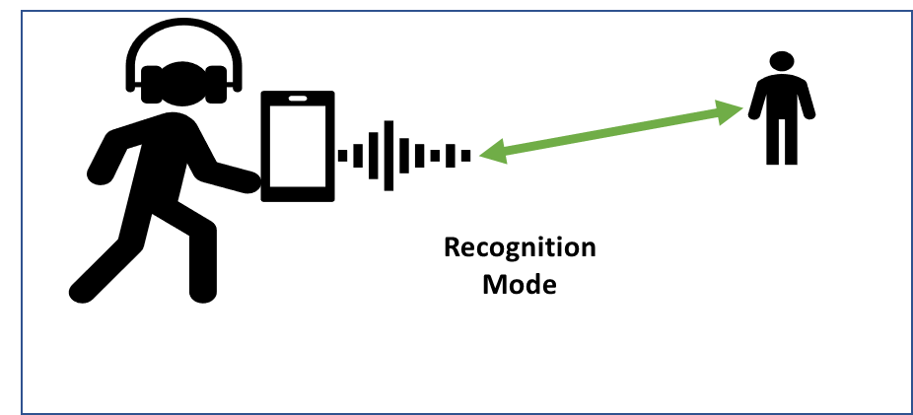
PROBLEM STATEMENT & EXPECTATIONS – VIRTUAL ASSIST
Business Context
In an increasingly crowded as well as distracted world, an extra pair of eyes could prove to be a blessing to prevent many accidents, provide navigational guidance and even dial emergency services when required. More so, it could become a trusted aid and lifeline for our visually challenged friends. Early Warning: A lot of accidents on road with or without vehicles are preventable if only the party or parties involved were paying sufficient attention to the surroundings. Be it an upcoming pothole or a stray animal or a vehicle that has lost control or a distracted pedestrian and so on, a few seconds of advance information could prevent injury and loss of life in many scenarios. Last Step connectivity: While navigational apps do a great job of guiding us to the destination, once at the destination, a visually challenged person would still need help to reach the exact spot that they set out for. In such scenarios, this solution could spell out what is visible in the surrounding which would be a great help for the visually challenged person to navigate the last few steps to their real destination.
This solution aims at using the camera of the cellphone to spell out what is seen in surroundings. The captured information can then be processed and interpreted for a wide range of use cases depending on the user’s needs and preferences. For eg., in navigation mode, the solution must try to read and decipher the text that it comes across. In an alarm mode, it could provide timely warnings of incoming traffic, or obstacles, steps, uneven roads, open manholes and so on. In identification mode, it could be used to recognize the people who are approaching the user.

Slide 17
PROBLEM STATEMENT & EXPECTATIONS – VIRTUAL ASSIST CONTD.
Must Have Features
Must be able to gather and process information almost instantaneously with very minimal lag to be able to give timely alerts
Ability to identify obstacles and provide information/alert as applicable
Ability to identify approaching objects like speeding vehicles
User must have the option to configure how much of stream must be stored. As storage gets filled, older images/streams must be automatically and seamlessly overwritten
Ability to configure the modes and may choose to run multiple modes at the same time.
App should depend on the device OS and storage for speed and performance. App must not hamper the functioning of rest of the device
Good to Have Features
Ability to interpret distance from the approaching object based on noise, eg, approaching car from behind
Ability to “introduce” people to the app and recognize them and their gesture in future. Eg. Mr David waved Hello to you

Slide 18
PROBLEM STATEMENT & EXPECTATIONS – VIRTUAL ASSIST CONTD.
References
Datasets
India Driving Dataset https://idd.insaan.iiit.ac.in/dataset/details/
Traffic Signs https://www.transport.telangana.gov.in/html/pdf/road-signs-english.pdf
MS COCO https://cocodataset.org/
References
Deep Learning on Android https://www.tensorflow.org/lite/guide/android
Audio Recognition https://www.tensorflow.org/tutorials/audio/simple_audio
Sound Classification https://mikesmales.medium.com/sound-classification-using-deep-learning-8bc2aa1990b7
Google Colab https://colab.research.google.com/ (How to run server on Google Colab https://stackoverflow.com/questions/63833593/how-to-run-fastapi-uvicorn-in-google-colab, https://www.geeksforgeeks.org/how-to-run-flask-app-on-google-colab/ , https://medium.com/@kshitijvijay271199/flask-on-google-colab-f6525986797b )

Slide 19

LET THE CODING BEGIN!
Notes:
Please save the source video file in your system and go to Insert > Video > Video on my PC > Select the file to insert. The headline should remain visible. DO NOT SHARE THE VIDEO FILE EXTERNALLY.

